Slide 1
Emotion-Cause Pair Extraction: A New Task to Emotion Analysis in Texts
ADVISOR:JIA-LING KOH
SOURCE:ACL 2019
SPEAKER:LI-WEI LiU
DATA:2020/08/26
Notes:
講講標題

Slide 2
OUTLINE
Introduction
Method
Experiment
Conclusion

Slide 3
INTRODUCTION
ECE task v.s. ECPE task:
Input
Output
Output

Slide 4
INTRODUCTION Motivation
Two shortcomings in the current ECE task:
Emotions must be annotated before cause extraction in the test set.
Annotating emotion ignores the fact that emotions and causes are mutually indicative.
Consider the above shortcomings in ECE
↓
Emotion-Cause Pair Extraction(ECPE)

Slide 5
OUTLINE
Introduction
Method
Experiment
Conclusion

Slide 6
METHOD Problem definition
Input a document contains multiple clauses : d = [c₁, c₂, … , c_{|d|}]
Each c_{i} also contains multiple words : c_{i} = [w_{i,1},w_{i,2}, … ,w_{i,|ci|}]
Output is emotion-cause pairs in d : P = { ... , (c^{e}, c^{c}), ... }
Notes:
P這樣表示，代表可能不只一組

Slide 7
METHOD two-step method
Emotion-Cause Pair Extraction(ECPE) : a two-step method
Step 1 : Individual Emotion and Cause Extraction
Extract a set of emotion clauses E = {c^{e} ₁, … , c^{e} _{m}}
and a set of cause clauses C = {c^{c} ₁, … , c^{c} _{n}} for each document.
Step 2 : Emotion-Cause Pairing and Filtering

Slide 8
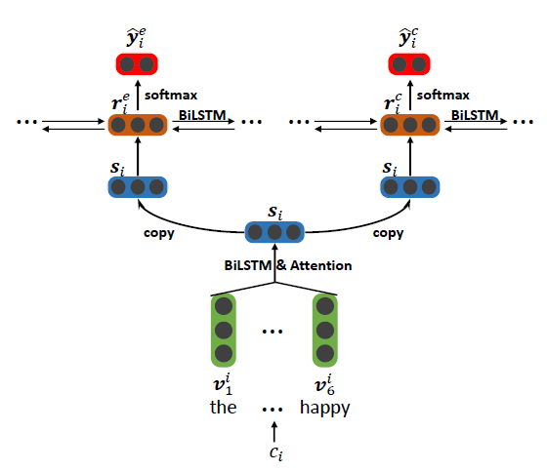
Independent Multi-task Learning

Slide 9
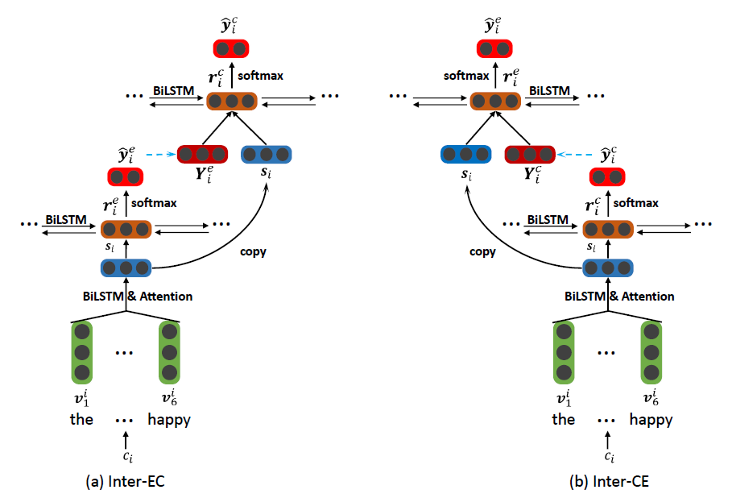
Interactive Multi-task Learning
Consider that emotion and cause aremutually indicative…
Notes:
考慮到情感和原因是相互指示的

Slide 10
METHOD Independent Multi-task Learning
Hierarchical Bi-LSTM network (two-layer):
to capture “word-clause-document” structure
The lower layer : word-level Bi-LSTM modules
Each c_{i} get a clause representation s_{i}
The upper layer : clause-level Bi-LSTM modules
Each s_{i} get a hidden states r_{i}
Notes:
emotion跟cause是分開extraction的，且結構一樣

Slide 11
METHOD Independent Multi-task Learning
Prediction : Softmax layer
Loss fuction :
Le and L^{c} are the cross-entropy error

Slide 12
METHOD Interactive Multi-task Learning
Take Inter-EC as an example
The lower layer : word-level Bi-LSTM modules
Each c_{i} get a clause representation s_{i}
The upper layer : clause-level Bi-LSTM modules
Each s_{i} get a hidden states r_{i}
Prediction : Softmax layer
For emotion extraction!
Notes:
用Inter-EC舉例，那Inter-EC是用擷取emotion來提升cause擷取的準確度的概念。

Slide 13
METHOD Interactive Multi-task Learning
Concated and Bi-LSTM+Softmax
Loss fuction :

Slide 14
METHOD Emotion-Cause Pairing and Filtering
In Step 1,we extraction emotion and cause sets
a set of emotion clauses E = {c^{e} ₁, … , c^{e} _{m}}
a set of cause clauses C = {c^{c} ₁, … , c^{c} _{n}}
Step 2 : Emotion-Cause Pairing and Filtering
Pairing : Cartesian product to E and C ,get all possible pairs:

Slide 15
METHOD Emotion-Cause Pairing and Filtering
Filtering
First , represent each pair in P_{all} :
where v^{d} represents the distances between the two clauses.
Then , use Sigmoid function to filter all candidate pair (c^{e}_{i} , c^{c}_{j})
whether c^{e}_{i} and c^{c}_{j} not have a causal relationship:
Notes:
對每個候選配對給定，結合兩個句子的距離變數得到新的表示方法

Slide 16
OUTLINE
Introduction
Method
Experiment
Conclusion

Slide 17
EXPERIMENT DataSets
We constructed a ECPE corpus based on the benchmark ECE corpus
Notes:
將ECE corpu合併成符合ECPE task預定義的規格
1對1 1對2 1對多 各占多少

Slide 18
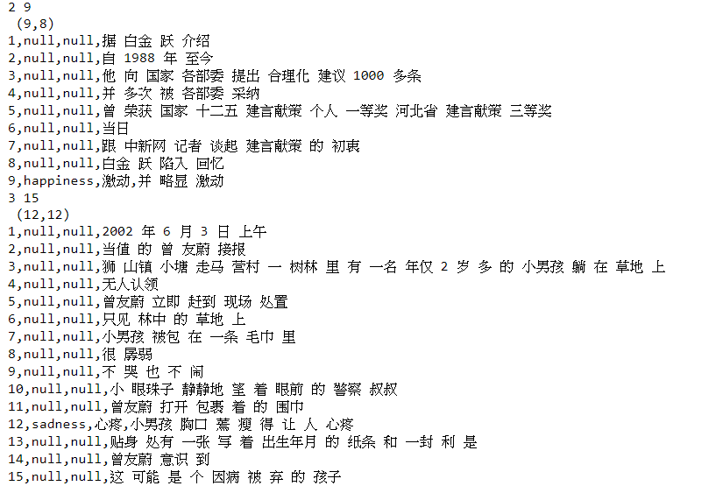
EXPERIMENT DataSets
Notes:
這頁不用印給他們!!!!!!!!!!!!!!!!!!!!!!!!!!!!!!!!!!!!!!!!

Slide 19
EXPERIMENT Evaluation on the ECPE Task
We repeat the experiments 20 times and report the average result.
Notes:
Upper-Bound的實驗想表示，emotion跟cause的確有明顯的相互關係，實驗結果符合Inter-EC跟Inter-CE的設計理念

Slide 20
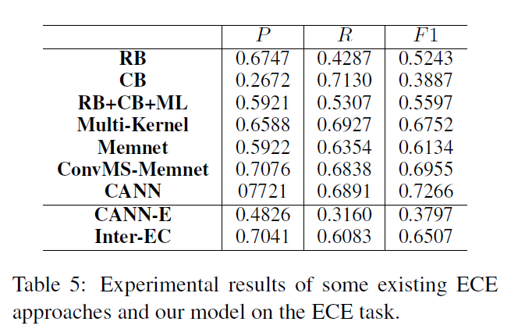
EXPERIMENT Comparison Methods
Notes:
強調本篇方法未標記emotion的情況下，仍然能表現得很好，且比以往的方法拿掉標記的情況好很多

Slide 21
OUTLINE
Introduction
Method
Experiment
Conclusion

Slide 22
CONCLUSION
We propose a new task: emotion-cause pair extraction(ECPE).
We propose a two-step method:
Extract both emotions and causes respectively by multi-task learning.
Emotion-Cause Pairing and Filtering.
Based on a benchmark ECE corpus, we construct a corpus suitable for the ECPE task. The experimental results prove the effectiveness of our method.
Notes:
看要不要講future work

